Slide 1

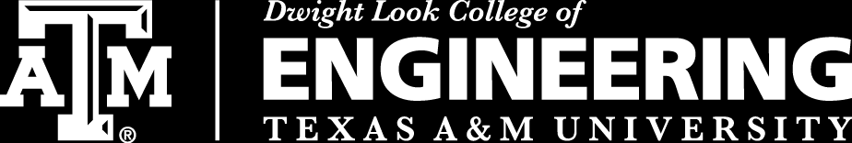
Team 16: Fault Classification on Power Cables
Adam Reed
Aayush Bhattarai
Keith Adams
TA: Qasim Khan
Sponsor: Qasim Khan

Slide 2
Problem Statement
“As power cables age their insulation wears down. Overtime this wear will cause the power cable to start producing partial discharge pulses. Eventually the partial discharges will lead to cable failure”
“To help reduce the impact of partial discharge we will be taking in the signal of a wire and determining what if any discharge is present. This will let our users react to the discharge.”

Slide 3
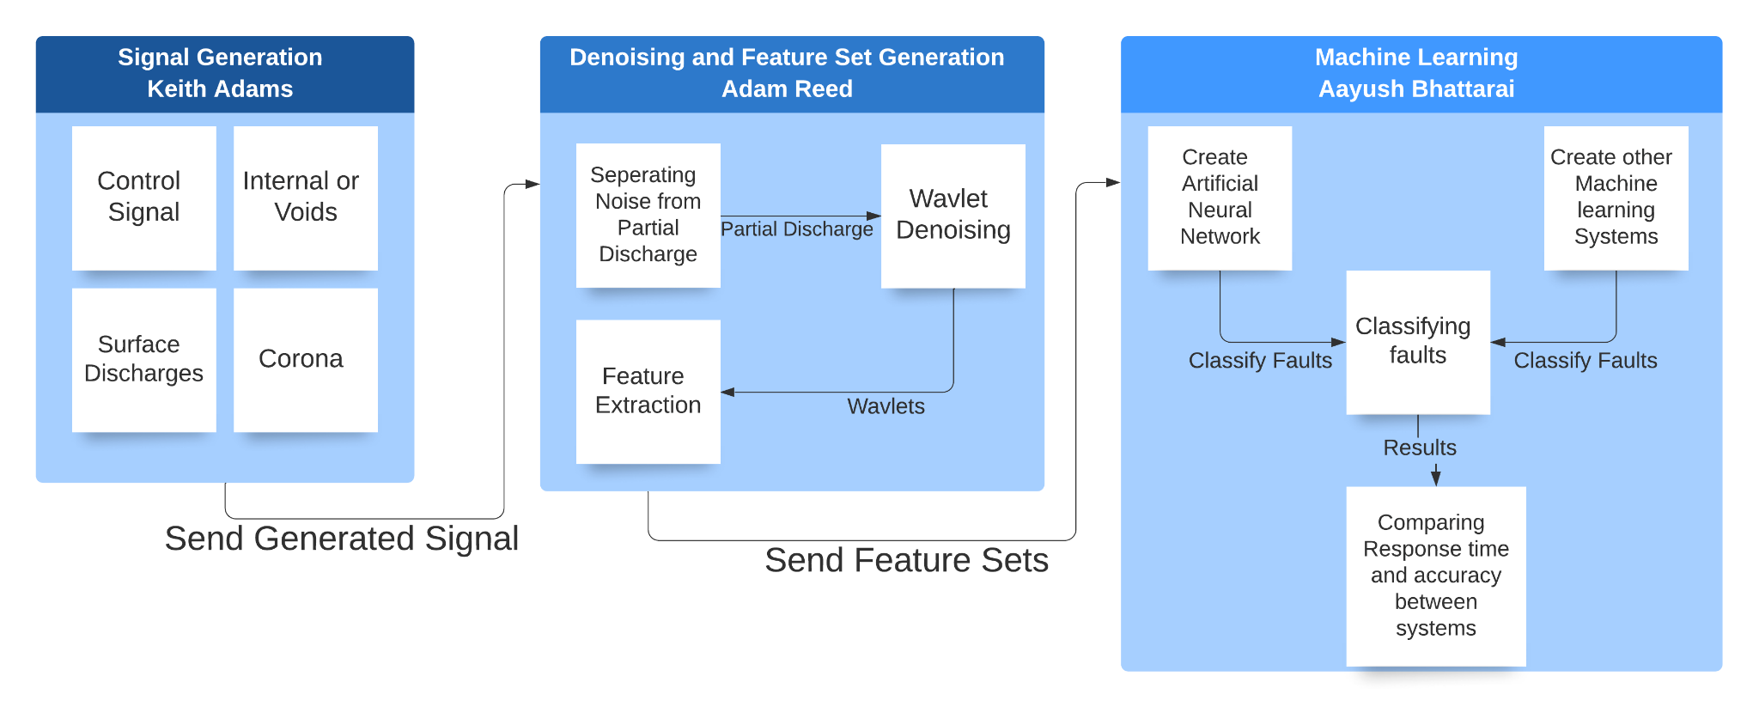
Subsystems Diagram

Slide 4
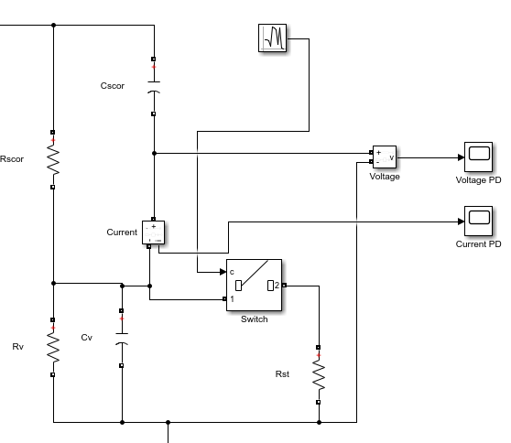
Signal Generation - Keith
Went through several revisions and two models
Models Void discharge.
Cv and Rv control the Void’s size.

Slide 5
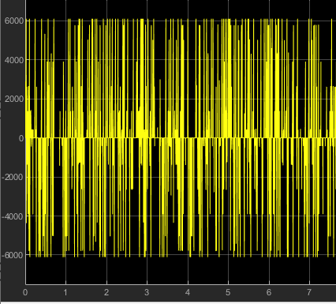
Signal Generation - Keith
Partial discharge signal.
Discharge is happening at random intervals.
The Larger voids will have bigger spikes.

Slide 6
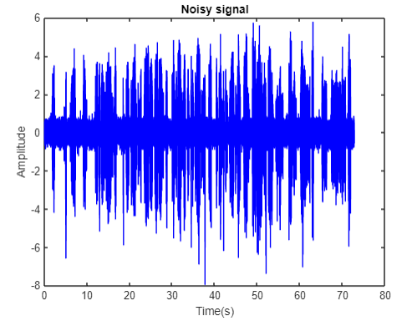
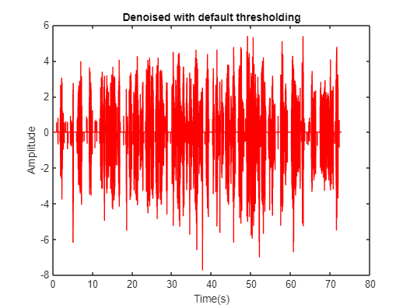
Signal Processing - Adam
xlabel('Time(s)')
ylabel('Amplitude')
Wavelet denoising performed of various db and symlet family waveforms
Method with the lowest MSE selected

Slide 7
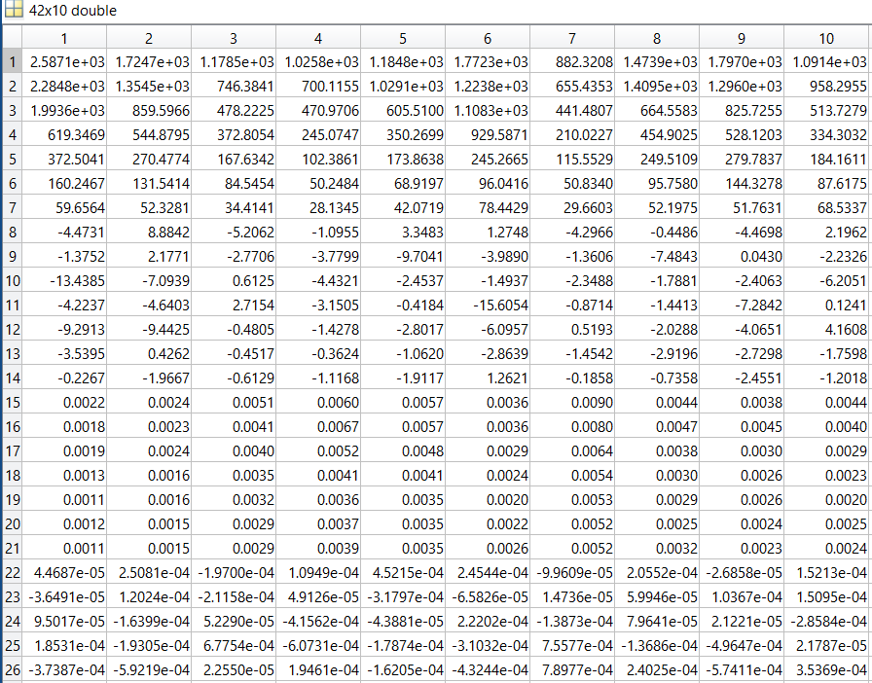
Signal Processing - Adam
xlabel('Time(s)')
ylabel('Amplitude')
Time signal broken up into 10 blocks, then denoised to 7 levels
6 features extracted from each level in each block combined in a 420 Feature matrix
FEATURE MATRIX

Slide 8
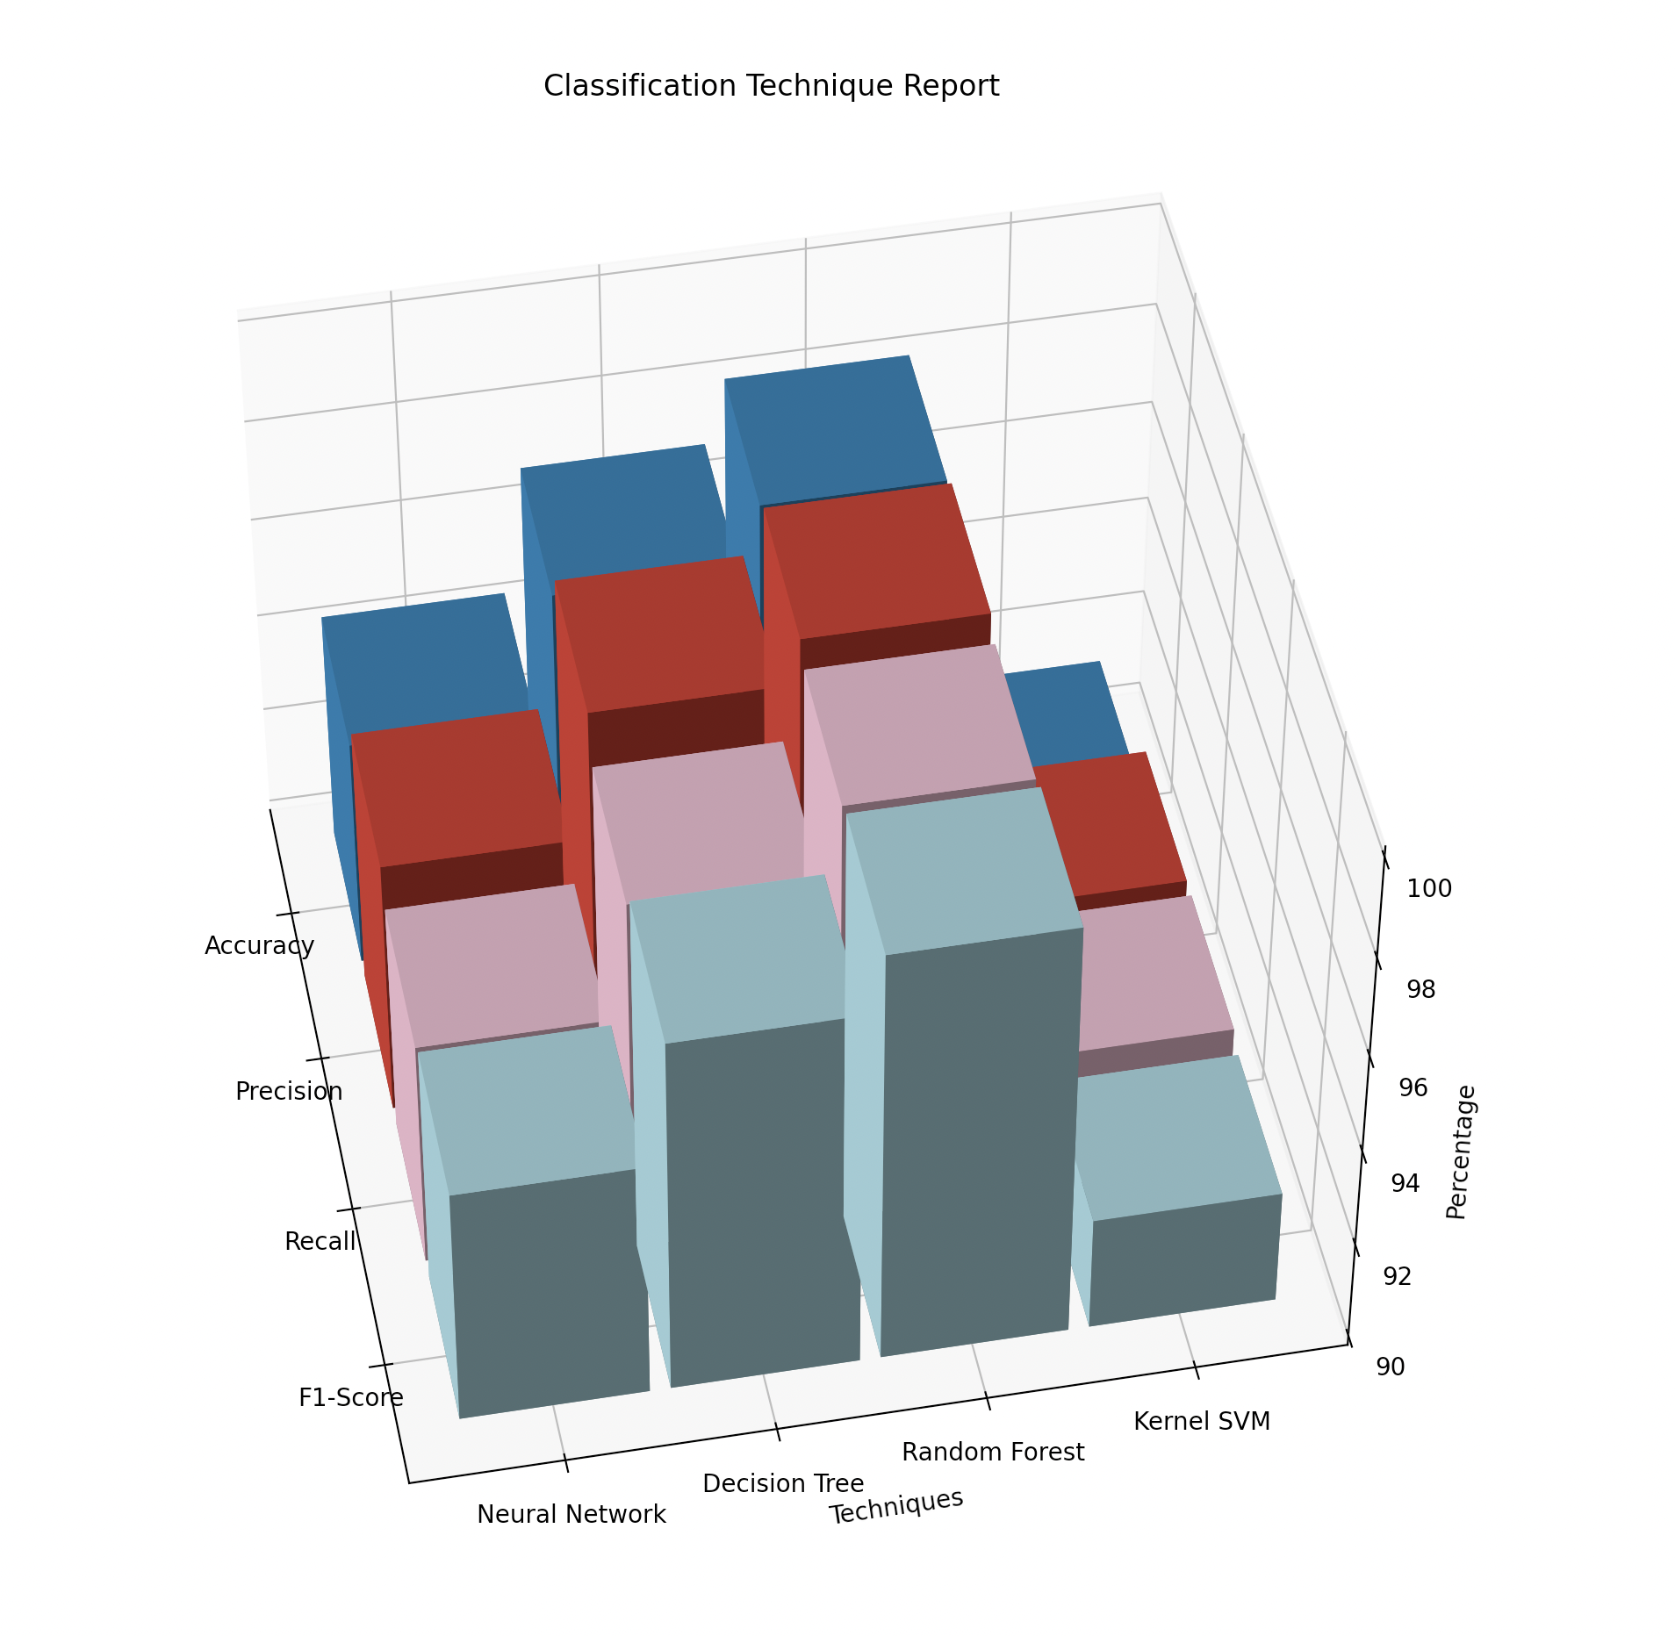
AI and ML - Aayush
Normalize the Data
Splitted the Feature Matrix into Training and Test Sets
Created 4 different models (Artificial Neural Network, Decision Tree Classification, Random Forest Classification, and Kernel SVM).
Trained the model with training set
Saved those model for future (.ckpt) and (.sav)

Slide 9
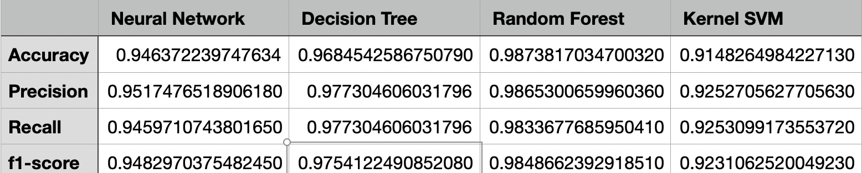
AI and ML (Continued)
Classification report for each model on the test set.
Normalizing the validation set (Experimental Data)

Slide 10
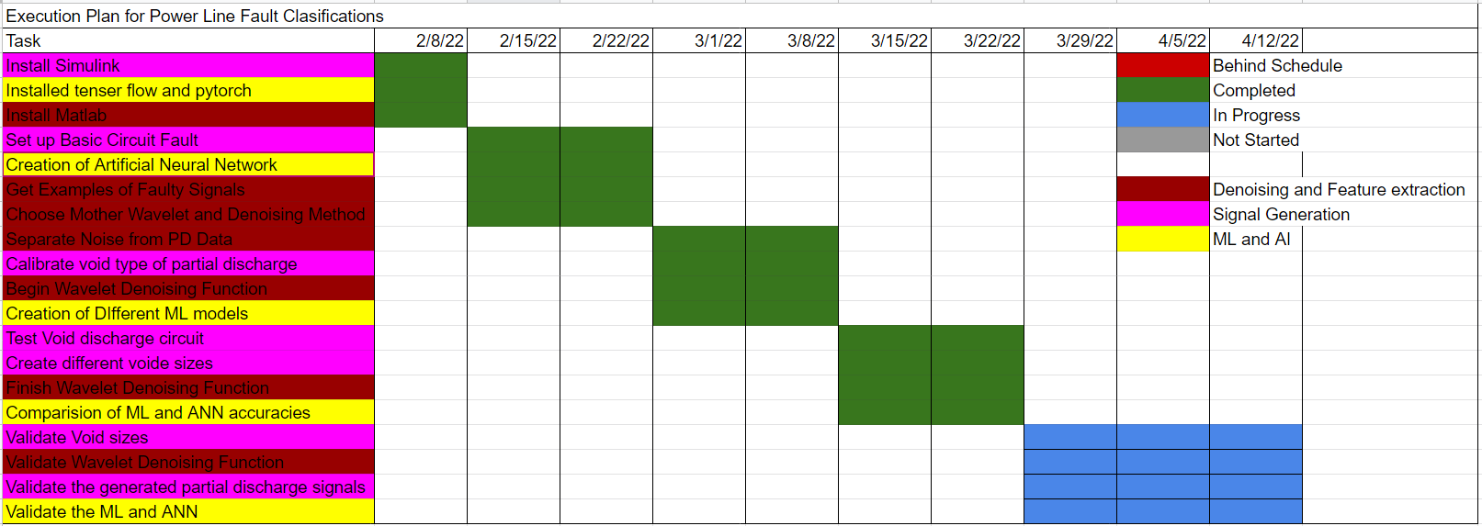
Execution Plan

Slide 11
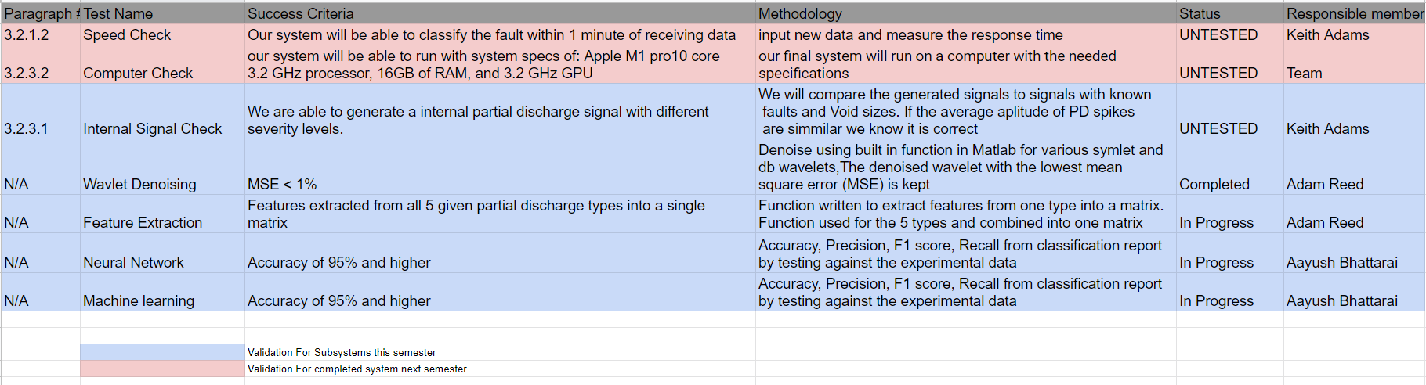
Validation Plan

Slide 12
Remaining Tasks
Signal Generation: Validate the generated partial discharge signals.
Signal Denoising: Validate that the denoising method works for the remaining PD types, Compile fully complete feature matrix data into matfile file.
ML and AI: Validate the Machine Learning and ANN model against the Experimental Data provided by the Sponsor, and Hyperparameter Tuning for better results.

Slide 13
Looking Ahead to 404
Signal Generation: Create models for different types of wires (different voltages, frequencies, and insulation material). Look into modeling different types of Partial Discharge.
Signal Processing & Feature Extraction: Optimize denoising and feature extraction code so that it runs faster. Develop an easier way to pass data to ML subsystem.
ML and AI: Choosing the best model by rigorous testing and save the model to be used in the GUI
Bringing it all together: We plan on integrating all of our subsystems into one program a user can install and interact with.

